Slide 1
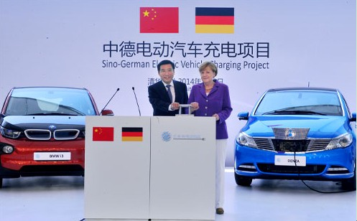
Research background
Notes:
It involves EV user behavior study, EV infrastructure planning, car-sharing business model study,battery and EV policy making. Several cities and universities are participating in this project.

Slide 2
Data Resources
2016.01.01~2016.03.31
All data
Taxi; Bus; Subway
Notes:
More Than 10 MILLION Taxi Data Each Day
Whole real data

Slide 3
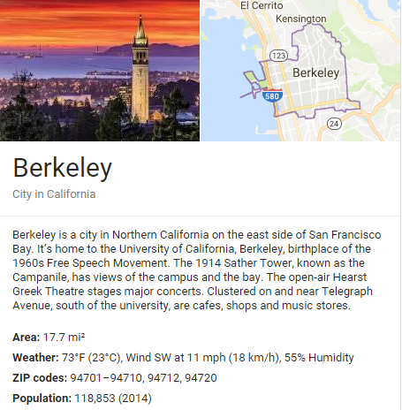
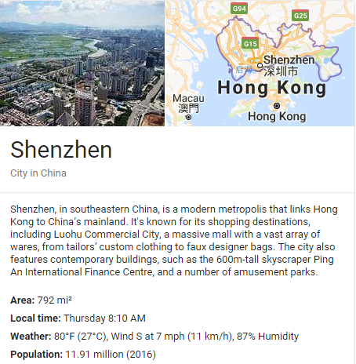
About Shenzhen
45 times
100 times
Notes:
The population of Shenzhen is 100 times that of Berkeley.

Slide 4
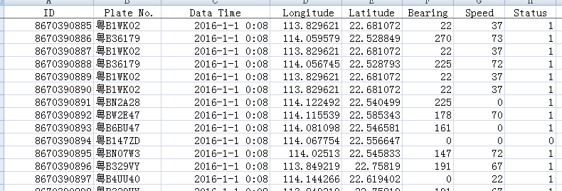
Data Resources
Taxi Data
16,000 taxies (more than 10 million taxi data per day)
Notes:
Each taxi has installed a GPS on the car.

Slide 5
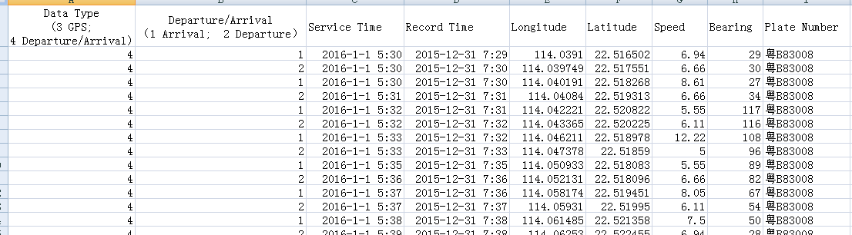
Data Resources
Bus Data
15,000 buses (4 bus companies)

Slide 6
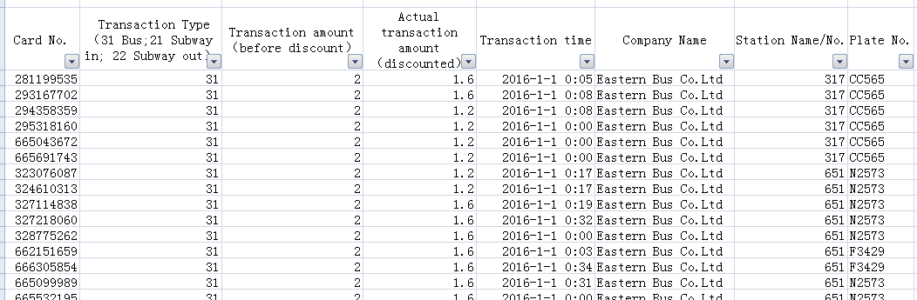
Data Resources
Transportation Card Data
Every card

